Slide 1
INFO-3142
How Deep Learning Works

Slide 2
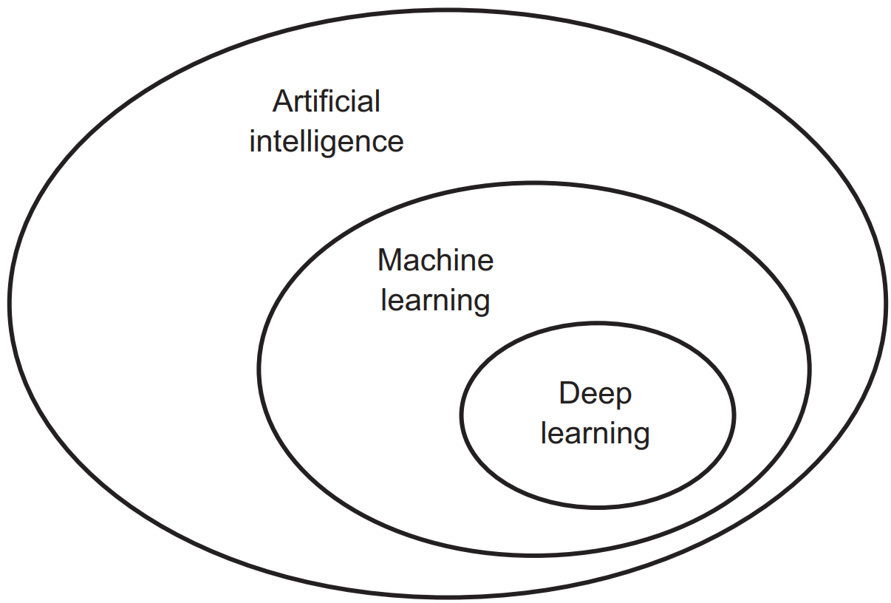
The AI-Hierarchy

Slide 3
Machine Learning
Computer algorithms that improve automatically through experience (Wikipedia definition)
We provide the training data, the algorithm develops the rules
Often equated with AI but is a sub-field

Slide 4
Deep Learning Basics
Based on neural networks
“Backpropagation”
“Curve fitting”
“Pattern matching”
Most of the current success in machine learning is based on this approach

Slide 5
1. Data Transformation
The central problem in deep learning is to meaningfully transform data
i.e. learn useful representations of the input data at hand
Representations that get us closer to the expected output

Slide 6
2. Data Transformation
What’s a representation?
Example:
A color image can be encoded in the RGB format (red-green-blue) or in the HSV format (hue-saturation-value)
Two different representations of the same data

Slide 7
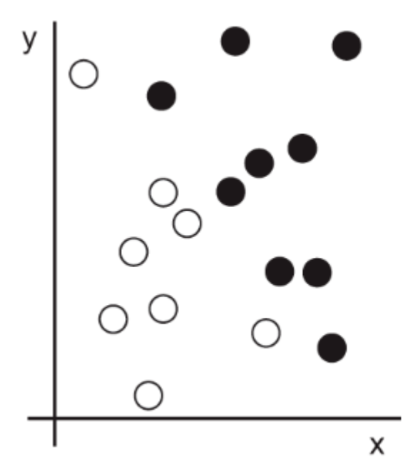
1. Example Transformation
Consider an x-axis, a y-axis, and some points represented by their coordinates in the (x, y) system

Slide 8
2. Example Transformation
As you can see, we have a few white points and a few black points
Let’s say we want to develop an algorithm that can take the coordinates (x, y) of a point and output whether that point is likely to be black or to be white
The inputs are the coordinates of our points
The expected outputs are the colors of our points
A way to measure whether our algorithm is doing a good job could be, for instance, the percentage of points that are being correctly classified

Slide 9
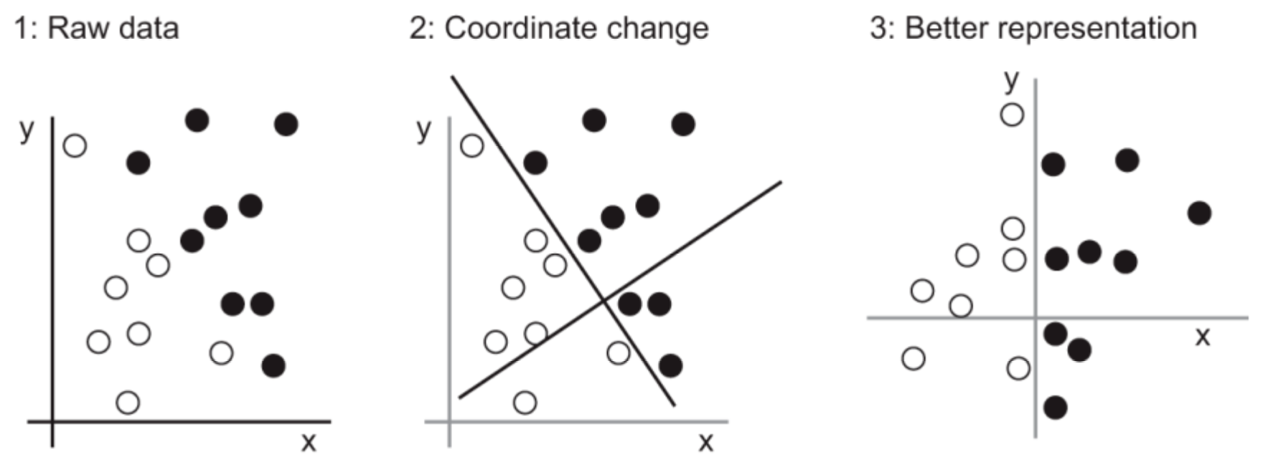
3. Example Transformation
What we need here is a new representation of our data that cleanly separates the white points from the black points
One transformation we could use, among many other possibilities, would be a coordinate change

Slide 10
4. Example Transformation
In this new coordinate system, the coordinates of our points can be said to be a new representation of our data
With this representation, the black/white classification problem can be expressed as a simple rule:
Black points are such that x > 0 or
White points are such that x < 0
The new representation, combined with this simple rule, neatly solves the classification problem

Slide 11
5. Example Transformation
In this case, we defined the coordinate change by hand:
We used our human intelligence to discover our own appropriate representation of the data
This is fine for such an extremely simple problem, but could you do the same if the task were (for example), to classify images of handwritten digits?
Could you write down explicit, computer-executable image transformations that would show the difference between a 6 and an 8, between a 1 and a 7, across all kinds of different handwritings?

Slide 12
6. Example Transformation
This is possible to an extent
Rules based on representations of digits such as “number of closed loops”, or vertical and horizontal pixel histograms (yet another representation) can do a decent job at telling apart handwritten digits
But finding such useful representations by hand is hard work, and as you can imagine the resulting rule-based system would be brittle
Every time you would come across a new example of handwriting that would break your carefully thought-out rules, you would have to add new data transformations and new rules, while taking into account their interaction with every previous rule

Slide 13
7. Example Transformation
You’re probably thinking, if this process is so painful, could we automate it?
What if we tried systematically searching for different sets of automatically-generated representations of the data and rules based on them, identifying good ones by using as feedback the percentage of digits being correctly classified in some development dataset
We would then be doing machine learning
Learning, in the context of machine learning, describes an automatic search process for Learning data transformations that produce useful representations of some data, guided by some feedback signal
i.e. representations that are amenable to simpler rules solving the task at hand

Slide 14
8. Example Transformation
In summary, that’s what machine learning is
Searching for useful representations and rules:
Based on some input data
Within a predefined space of possibilities
Using guidance from a feedback signal
We need a feedback signal to know if we’re making progress
This simple idea allows for solving a remarkably broad range of intellectual tasks, from speech recognition to autonomous driving

Slide 15
1. Deep Learning
Deep learning is a specific subfield of machine learning:
A new take on learning representations from data that puts an emphasis on learning successive layers of increasingly meaningful representations
Modern deep learning often involves tens or even hundreds of successive layers of representations, and they’re all learned automatically from exposure to training data

Slide 16
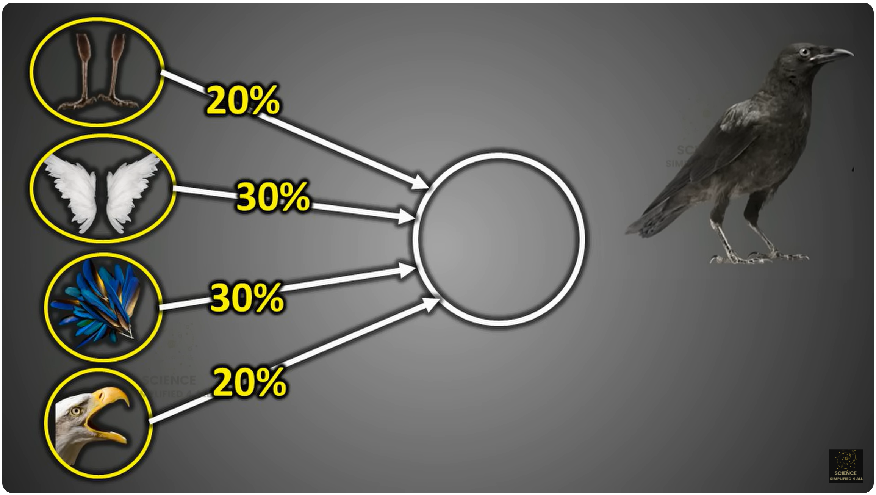
1. Deep Learning Concepts

Slide 17
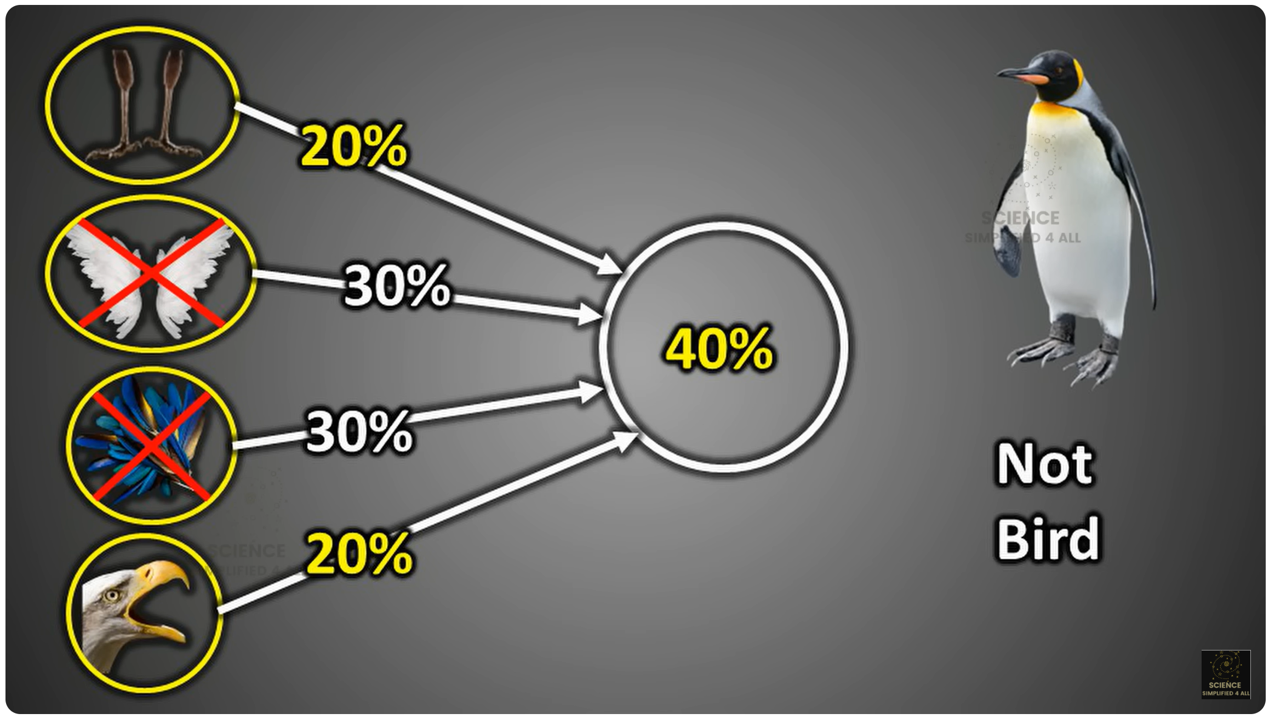
2. Deep Learning Concepts

Slide 18
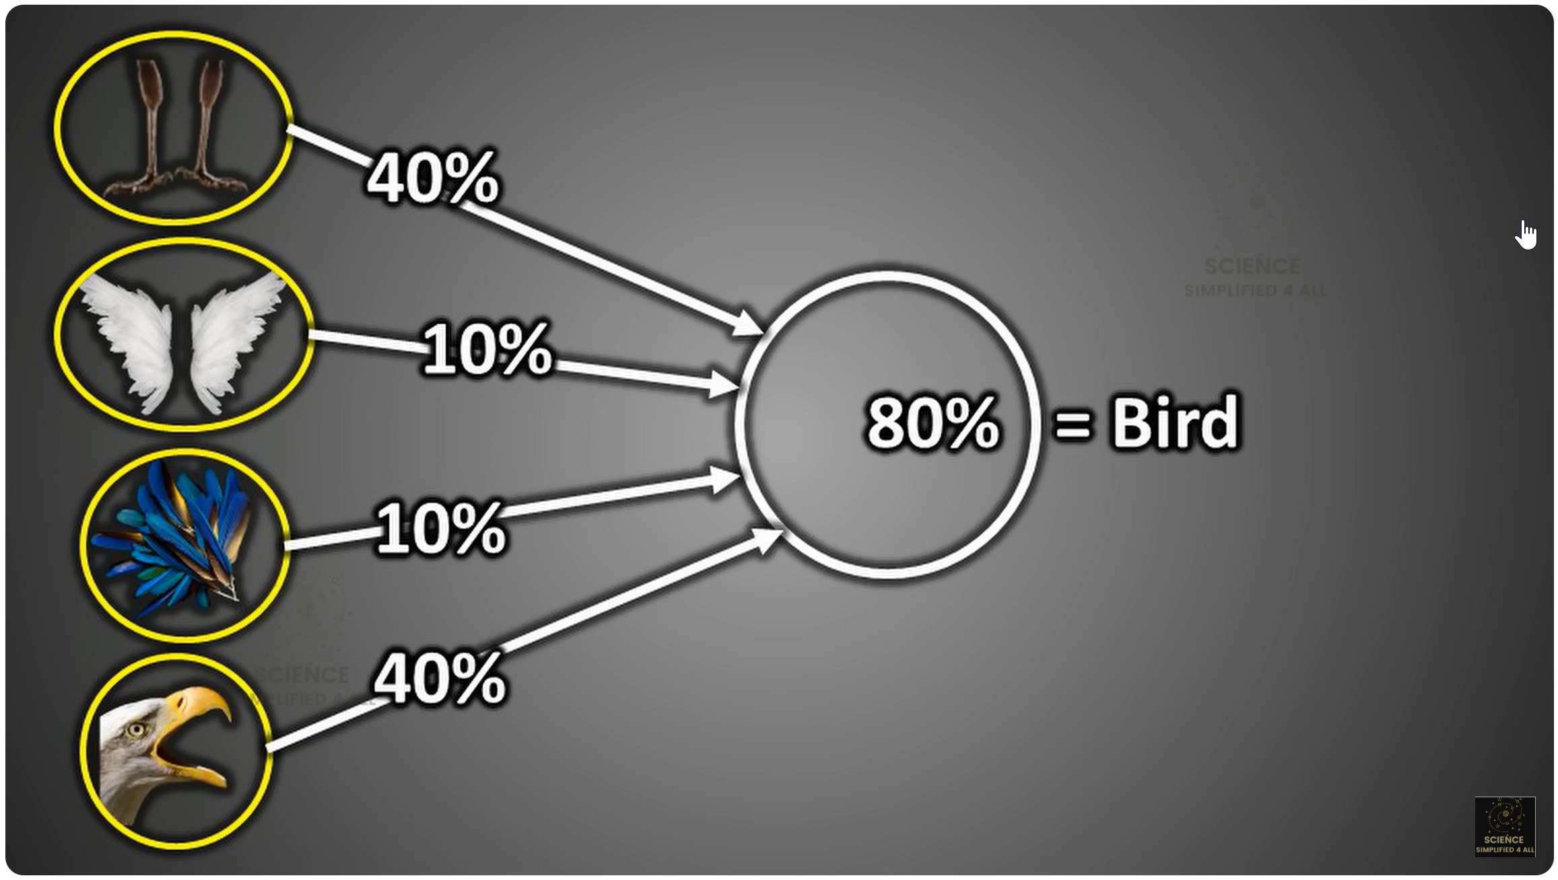
3. Deep Learning Concepts

Slide 19
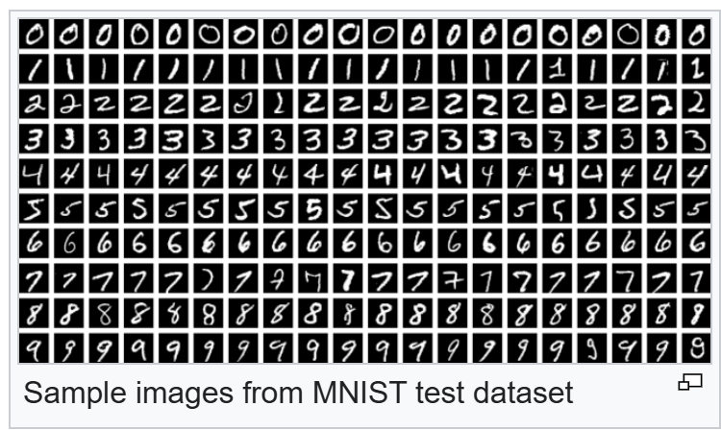
1. MNIST Database
Modified National Institute of Standards and Technology database
The “Hello World” of deep neural networks

Slide 20
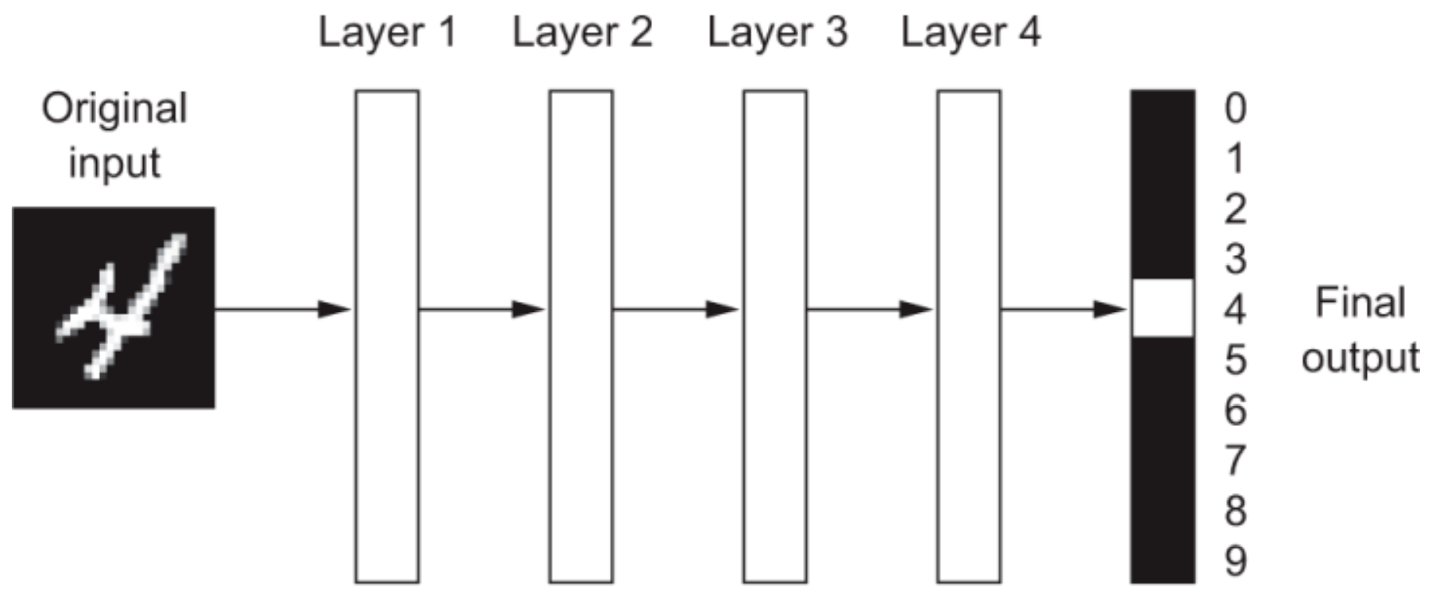
2. MNIST Database
What do the representations learned by a deep-learning algorithm look like?
Consider that a network several layers deep, transforms an image of a digit to recognize what digit it is

Slide 21
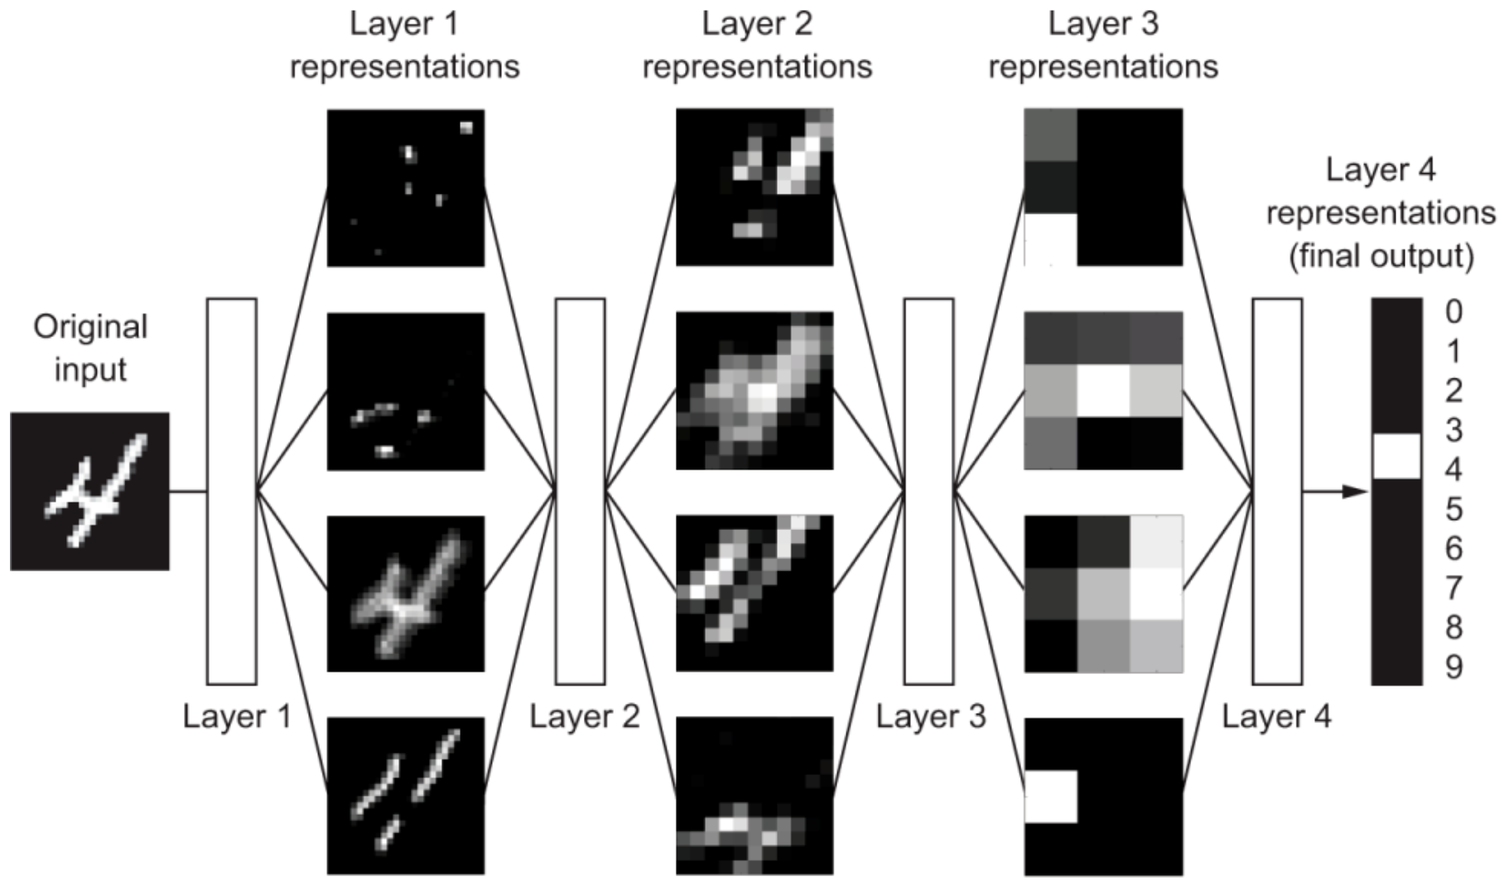
3. MNIST Database
The network transforms the digit image into representations that are increasingly different from the original image and increasingly informative about the result
You can think of a deep network as a multistage information-distillation operation, where information goes through successive filters

Slide 22
1. How Deep Learning Works
Machine learning is about mapping inputs (such as images) to targets (such as the label “cat”), which is done by observing many examples of input and targets
Deep neural networks do this input-to-target mapping via a deep sequence of simple data transformations (layers) such that these data transformations are learned by exposure to examples

Slide 23
2. How Deep Learning Works
The specification of what a layer does to its input data is stored in the layer’s weights which in essence are a bunch of numbers
Weights are also sometimes called the parameters of a layer
Learning means finding a set of values for the weights of all layers in a network, such that the network will correctly map example inputs to their associated targets
A deep neural network can contain tens of millions of parameters

Slide 24
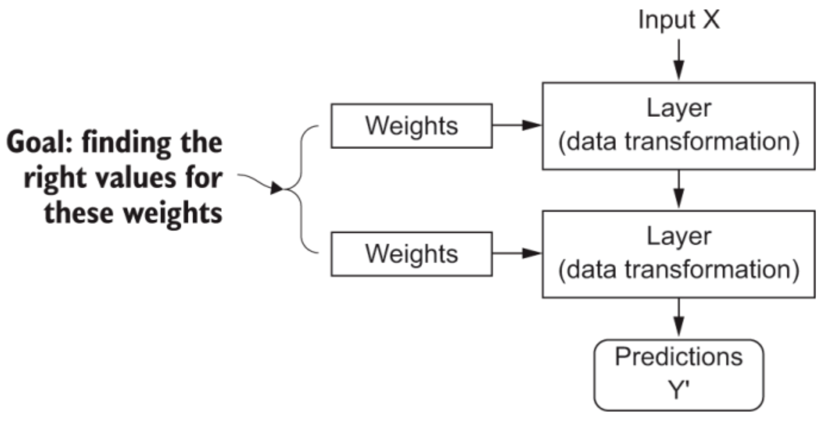
3. How Deep Learning Works

Slide 25
4. How Deep Learning Works
To control the output of a neural network, you need to be able to measure how far this output is from what you expected.
This is the job of the loss function of the network
The loss function takes the predictions of the network and the true target (what you wanted the network to output) and computes a distance score, capturing how well the network has done on this specific example

Slide 26
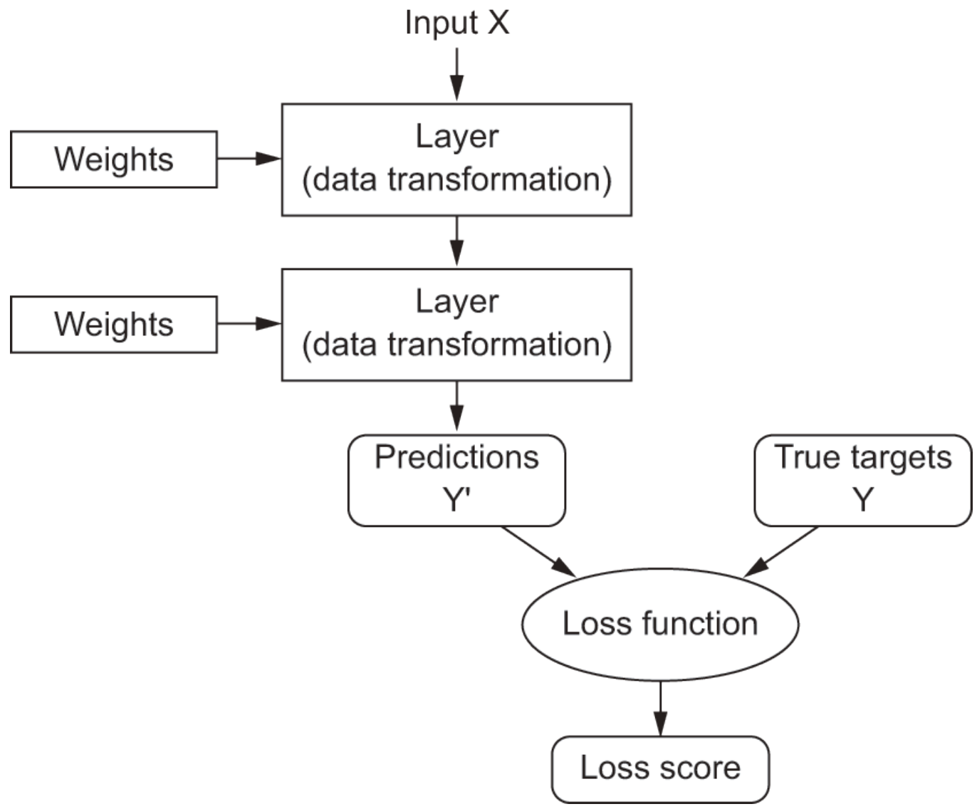
5. How Deep Learning Works

Slide 27
6. How Deep Learning Works
The fundamental trick in deep learning is to use this score as a feedback signal to adjust the value of the weights a little, in a direction that will lower the loss score for the current example
This adjustment is the job of the optimizer, which implements what’s called the Backpropagation algorithm
This is the central algorithm in deep learning

Slide 28
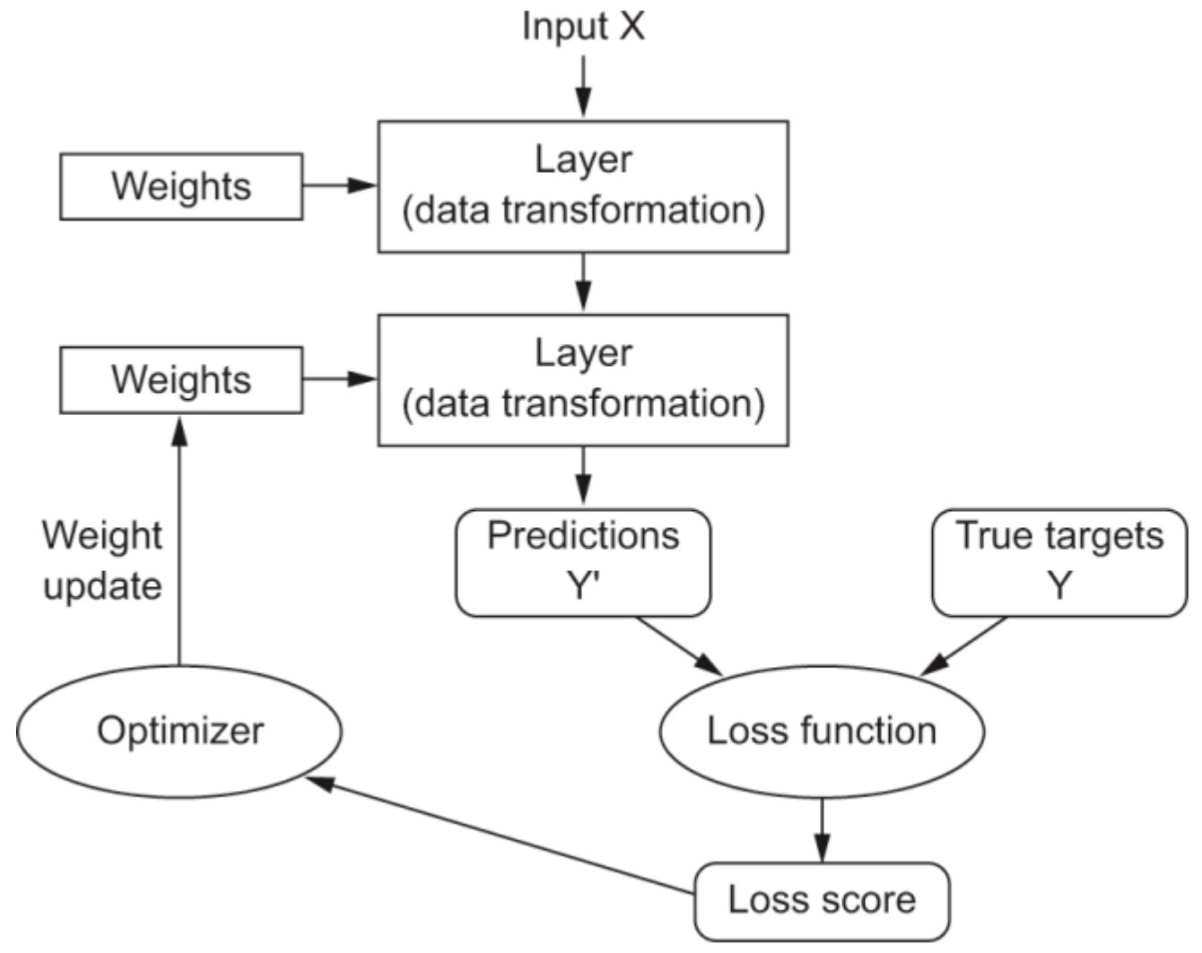
7. How Deep Learning Works

Slide 29
8. How Deep Learning Works
Initially, the weights of the network are assigned random values, so the network merely implements a series of random transformations
Naturally, its output is far from what it should ideally be, and the loss score is accordingly very high
But with every example the network processes, the weights are adjusted a little in the correct direction, and the loss score decreases

Slide 30
9. How Deep Learning Works
This is the training loop, which, repeated a sufficient number of times (typically tens of iterations over thousands of examples), yields weight values that minimize the loss function
A network with a minimal loss is one for which the outputs are as close as they can be to the targets
This results in a trained network

Slide 31
1. Backpropagation
The method neural networks use to learn from mistakes
It’s how the network updates its internal weights after making a wrong prediction

Slide 32
2. Backpropagation
Forward pass:
Input data flows through the network layer by layer, and the network makes a prediction
Error calculation:
The prediction is compared to the correct answer (the "label") using a loss function
This gives a number that tells us how wrong the prediction was

Slide 33
3. Backpropagation
Backward pass (backpropagation):
The error is sent backward through the network
Using the chain rule from calculus, the algorithm figures out how much each weight in the network contributed to the error
Weight update:
Each weight is slightly adjusted (using an optimizer like gradient descent) so the network’s predictions will be closer to the correct answer next time

Slide 34
4. Backpropagation
Imagine teaching a student to throw a dart at a target
Forward pass: They throw it (make a prediction)
Error: You measure how far off it was
Backward pass: You give feedback - “too far left, a bit too low”
Update: The student corrects their throw (updates weights)
After enough practice, they get very close to the centre of the target

Slide 35
1. A Final Mental Metaphor
Imagine two sheets of colored paper: one red and one blue
Put one on top of the other
Now crumple them together into a small ball
That crumpled paper ball is your input data, and each sheet of paper is a class of data in a classification problem
What a neural network is meant to do is figure out a transformation of the paper ball that would uncrumple it, so as to make the two classes cleanly separable again
With deep learning, this would be implemented as a series of simple transformations of the 3D space, such as those you could apply on the paper ball with your fingers, one movement at a time

Slide 36

2. A Final Mental Metaphor

Slide 37
3. A Final Mental Metaphor
Uncrumpling paper balls is what machine learning is about:
Finding neat representations for complex, highly-folded data manifolds in high-dimensional spaces (a manifold is a continuous surface, like our crumpled sheet of paper)
At this point, you should have a pretty good intuition as to why deep learning excels at this:
It takes the approach of incrementally decomposing a complicated geometric transformation into a long chain of elementary ones, which is pretty much the strategy a human would follow to uncrumple a paper ball
Each layer in a deep network applies a transformation that disentangles the data a little – and a deep stack of layers makes tractable an extremely complicated disentanglement process

Slide 38
4. A Final Mental Metaphor
Thanks to Francois Chollet:
Deep Learning with Python : Manning books

Slide 39
Introductory Video
https://www.youtube.com/watch?v=m8o2GrbR3d8

Slide 40
Deep Learning Videos (Really Good!)
MNIST Basic Concepts
Gradient Descent
Backpropagation

